Slide 1

CHARTS
Charts were very helpful to reduce the time to understand the huge data using graphical representation.
They are four types of charts
Statistical chart
AI/ML chart .
Financial chart
Scientific chart

Slide 2
Statistical chart
To plot all Matplotlib and Seaborn charts, Plotly offers a huge range of graphs and charts like Statistical Charts which includes but are not limited to Parallel Categories and Probability Tree Plots.
A statistical graph or chart is defined as the pictorial representation of statistical data in graphical form
Types of statistical charts
Error graph .
Box graph .
Histograms .
Distplots .
2D Histogram .
Scatterplot matrix .
Facet and trellis plots
Parallel categories diagram
tree plots
Violin plots
2D Histogram
Linear and non linear trendlines
Marginal distribution plots
Strip chart
Continuoun error bands
Empirical cumulative distribution plots

Slide 3
Distplots
Combined statistical representations with px.histogram. Several representations of statistical distributions are histograms, violin plots, box plots. It is also possible to combine several representations in the same plot. The plotly express function px.histogram can add a subplot with a different statistical representation than the histogram , provided by parameter marginal. Plotly Express is the easy-to-use, high-level interface to Plotly

Slide 4
Basic Distplots Codes
Having only 2 bar graphs in visuvalization is called as basic Distplots
Code to execute in colab
#import plotly and read the csv file(Data Processing)
import pandas as pd
import plotly.express as px
df = pd.read_csv('Survey on Student Mental Health1 (1).csv')
df.head()
import plotly.express as px
x = df.What_is_your_screen_time
y = df.How_much_time_are_you_sleeping_everyday
fig = px.histogram(x,y)
fig.show()

Slide 5
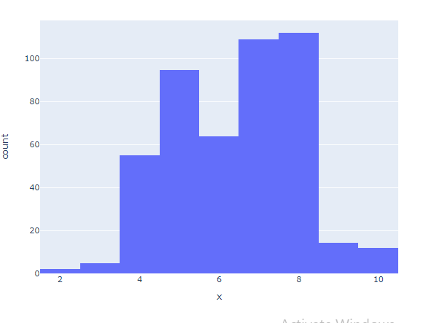
Basic Distplots Chart

Slide 6
Medium Distplots Codes
#import plotly and read the csv file(Data Processing)
import pandas as pd
import plotly.express as px
df = pd.read_csv('Survey on Student Mental Health1 (1).csv')
df.head()
import plotly.express as px
fig = px.histogram(df, x="What_is_your_screen_time", y="How_much_time_are_you_sleeping_everyday", color="Gender")
fig.show()

Slide 7
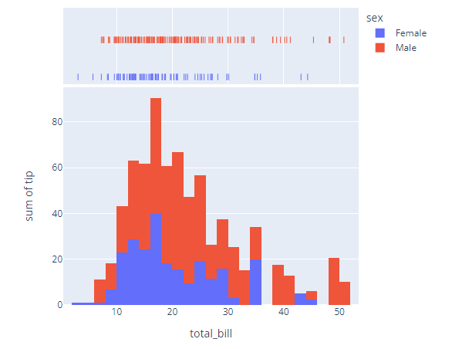
Medium Distplots Chart
In distplot possible to combine several representations in the same plot.by this we can compare between 2 categories.

Slide 8
Advanced Distplots
Having only 3 bargraphs and 2 linechart in visuvalization is called as basic Distplots
Code to execute in colab
import plotly.figure_factory as ff
import numpy as np
import pandas as pd
df = pd.DataFrame({'2012': np.random.randn(200),
'2013': np.random.randn(200)+1})
fig = ff.create_distplot([df[c] for c in df.columns], df.columns, bin_size=.25)
fig.show()

Slide 9
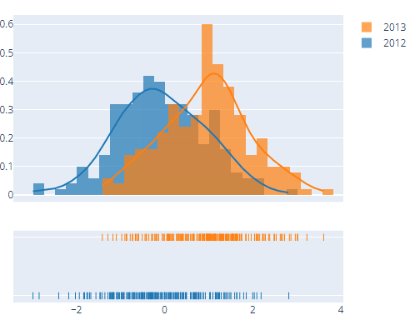
Advanced Distplots
In distplot possible to combine several representations in the same plot.by this we can compare between many categories.

Slide 10
Parallel Categories
The parallel categories diagram (also known as parallel sets or alluvial diagram) is a visualization of multi-dimensional categorical data sets.
Each attribute kept parallel and then each attribute split into different Categories
That Categories are inked with another categorical in other attribute .
Combinations of category rectangles across dimensions are connected by ribbons, where the height of the ribbon corresponds to the relative frequency of occurrence of the combination of categories in the data set.

Slide 11
Basic Parallel Categories
the restaurant bills of a sample of 244 people. category rectangle (sex, smoker, etc) displays a tooltip with the number of people with that single trait. Hovering over a ribbon in the diagram displays a tooltip with the number of people with a particular combination of the five traits connected by the ribbon.
import plotly.express as px
fig = px.parallel_categories(df, dimensions=['Gender', 'Why_did_you_chosen_your_department_work_area', 'On_what_do_you_spend_your_screen_time_more'],
color="Current_year_you_are_studying_in")
fig.show()

Slide 12
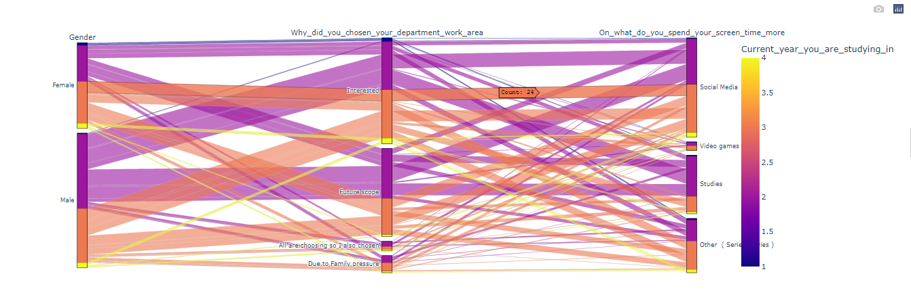
Basic Parallel Categories
In a parallel categories (or parallel sets) plot, each row of data_frame is grouped with other rows that share the same values of dimensions and then plotted as a polyline mark through a set of parallel axes, one for each of the dimensions

Slide 13
Advanced Parallel Categories
Parallel Categories with Multi-Color Linked Brushing
This example extends the previous example to support brushing with multiple colors. The toggle buttons above may be used to select the active color, and this color will be applied when points are selected in the scatter trace and when categories or ribbons are clicked in the parcats trace.
import plotly.graph_objects as go
import ipywidgets as widgets
import pandas as pd
import numpy as np
cars_df = pd.read_csv('https://raw.githubusercontent.com/plotly/datasets/master/imports-85.csv')
# Build parcats dimensions
categorical_dimensions = ['body-style', 'drive-wheels', 'fuel-type']
dimensions = [dict(values=cars_df[label], label=label) for label in categorical_dimensions]

Slide 14
# Build colorscale
color = np.zeros(len(cars_df), dtype='uint8')
colorscale = [[0, 'gray'], [0.33, 'gray'],
[0.33, 'firebrick'], [0.66, 'firebrick'],
[0.66, 'blue'], [1.0, 'blue']]
cmin = -0.5
cmax = 2.5
# Build figure as FigureWidget
fig = go.FigureWidget(
data=[go.Scatter(x=cars_df.horsepower, y=cars_df['highway-mpg'],
marker={'color': color, 'cmin': cmin, 'cmax': cmax,
'colorscale': colorscale, 'showscale': True,
'colorbar': {'tickvals': [0, 1, 2], 'ticktext': ['None', 'Red', 'Blue']}},
mode='markers'),
go.Parcats(domain={'y': [0, 0.4]}, dimensions=dimensions,
line={'colorscale': colorscale, 'cmin': cmin,
'cmax': cmax, 'color': color, 'shape': 'hspline'})]
)
fig.update_layout(height=800, xaxis={'title': 'Horsepower'},
yaxis={'title': 'MPG', 'domain': [0.6, 1]},
dragmode='lasso', hovermode='closest')
# Build color selection widget
color_toggle = widgets.ToggleButtons(
options=['None', 'Red', 'Blue'],
index=1, description='Brush Color:', disabled=False)

Slide 15
# Update color callback
def update_color(trace, points, state):
# Compute new color array
new_color = np.array(fig.data[0].marker.color)
new_color[points.point_inds] = color_toggle.index
with fig.batch_update():
# Update scatter color
fig.data[0].marker.color = new_color
# Update parcats colors
fig.data[1].line.color = new_color
# Register callback on scatter selection...
fig.data[0].on_selection(update_color)
# and parcats click
fig.data[1].on_click(update_color)
# Display figure
widgets.VBox([color_toggle, fig])

Slide 16
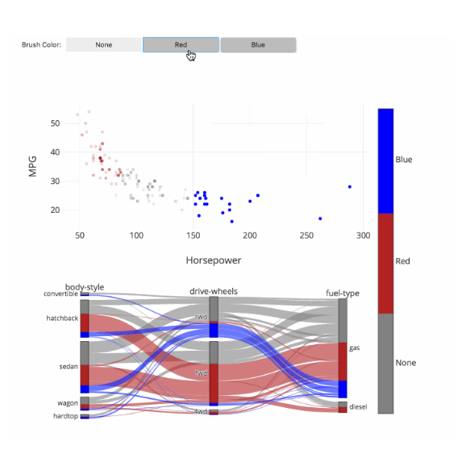
Advanced Parallel Categories
The toggle buttons above may be used to select the active color, and this color will be applied when points are selected in the scatter trace and when categories or ribbons are clicked in the parcats trace.

Slide 17
AI/ML CHARTS
Plotly Python Open Source Graphing Library Artificial Intelligence and Machine Learning Charts. Plotly's Python graphing library makes interactive, publication-quality graphs online. Examples of how to make charts related to artificial intelligence and machine learning.
ML regression
kNN classification
ROC and PR curves
PCA visualization
t-SNE and UMAP projections

Slide 18
ML regression
We will use Scikit-learn to split and preprocess our data and train various regression models. Scikit-learn is a popular Machine Learning (ML) library that offers various tools for creating and training ML algorithms, feature engineering, data cleaning, and evaluating and testing models. It was designed to be accessible, and to work seamlessly with popular libraries like NumPy and Pandas.

Slide 19
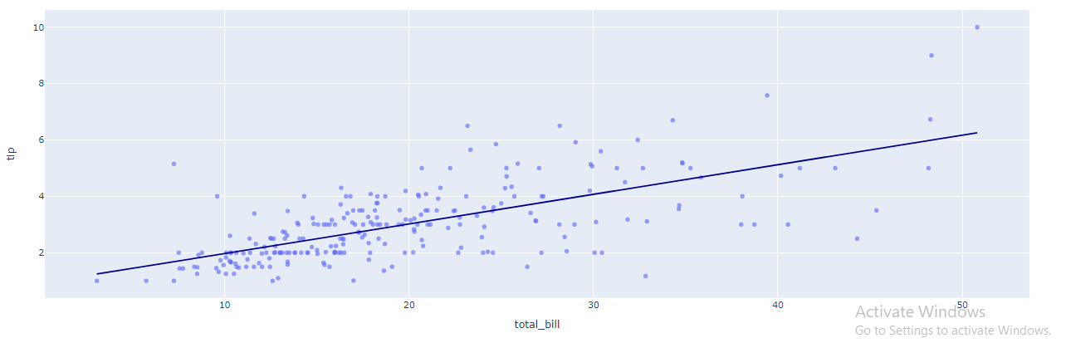
Basic linear regression plots
You can use simple linear regression when you want to know: How strong the relationship is between two variables

Slide 20
Basic linear regression plots
We will be using the Linear Regression, which is a simple model that fit an intercept (the mean tip received by a server), and add a slope for each feature we use, such as the value of the total bill. We show you how to do that with both Plotly Express and Scikit-learn.
import plotly.express as px
df = px.data.tips()
fig = px.scatter(
df, x='total_bill', y='tip', opacity=0.65,
trendline='ols', trendline_color_override='darkblue'
)
fig.show()

Slide 21
Visualize regularization across cross-validation folds
In this example, we show how to plot the results of various alpha penalization values from the results of cross-validation using scikit-learn's LassoCV. This is useful to see how much the error of the optimal alpha actually varies across CV folds.
import numpy as np
import pandas as pd
import plotly.express as px
import plotly.graph_objects as go
from sklearn.linear_model import LassoCV
N_FOLD = 6
# Load and preprocess the data
df = px.data.gapminder()
X = df.drop(columns=['lifeExp', 'iso_num'])
X = pd.get_dummies(X, columns=['country', 'continent', 'iso_alpha'])
y = df['lifeExp']
# Train model to predict life expectancy
model = LassoCV(cv=N_FOLD, normalize=True)
model.fit(X, y)
mean_alphas = model.mse_path_.mean(axis=-1)

Slide 22
fig = go.Figure([
go.Scatter(
x=model.alphas_, y=model.mse_path_[:, i],
name=f"Fold: {i+1}", opacity=.5, line=dict(dash='dash'),
hovertemplate="alpha: %{x} <br>MSE: %{y}"
)
for i in range(N_FOLD)
])
fig.add_traces(go.Scatter(
x=model.alphas_, y=mean_alphas,
name='Mean', line=dict(color='black', width=3),
hovertemplate="alpha: %{x} <br>MSE: %{y}",
))
fig.add_shape(
type="line", line=dict(dash='dash'),
x0=model.alpha_, y0=0,
x1=model.alpha_, y1=1,
yref='paper'
)
fig.update_layout(
xaxis_title='alpha',
xaxis_type="log",
yaxis_title="Mean Square Error (MSE)"
)
fig.show()

Slide 23
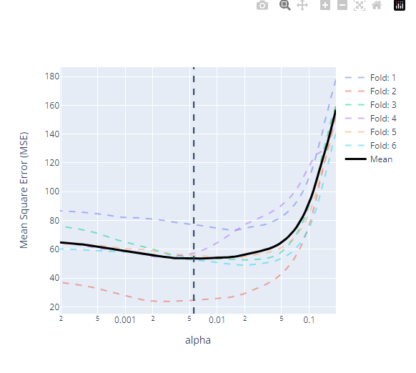
Visualize regularization across cross-validation folds
Cross-validation is usually used in machine learning for improving model prediction when we don’t have enough data to apply other more efficient methods

Slide 24
kNN Classification
We will train a k-Nearest Neighbors (kNN) classifier. First, the model records the label of each training sample. Then, whenever we give it a new sample, it will look at the k closest samples from the training set to find the most common label, and assign it to our new sample.

Slide 25
import plotly.express as px
import plotly.graph_objects as go
import numpy as np
from sklearn.neighbors import KNeighborsClassifier
mesh_size = .02
margin = 1
# We will use the iris data, which is included in px
df_train, df_test = train_test_split(df, test_size=0.25, random_state=0)
X_train = df_train[['How_much_time_are_you_sleeping_everyday', 'What_is_your_screen_time']]
y_train = df_train.concentrate_on_your_work_when_you_are_stressed
# Create a mesh grid on which we will run our model
l_min, l_max = df.How_much_time_are_you_sleeping_everyday.min() - margin, df.How_much_time_are_you_sleeping_everyday.max() + margin
w_min, w_max = df.What_is_your_screen_time.min() - margin, df.What_is_your_screen_time.max() + margin
lrange = np.arange(l_min, l_max, mesh_size)
wrange = np.arange(w_min, w_max, mesh_size)
ll, ww = np.meshgrid(lrange, wrange)
# Create classifier, run predictions on grid
clf = KNeighborsClassifier(15, weights='distance')
clf.fit(X_train, y_train)
Z = clf.predict(np.c_[ll.ravel(), ww.ravel()])
Z = Z.reshape(ll.shape)
proba = clf.predict_proba(np.c_[ll.ravel(), ww.ravel()])
proba = proba.reshape(ll.shape + (2,))
# Compute the confidence, which is the difference
diff = proba.max(axis=-1) - (proba.sum(axis=-1) - proba.max(axis=-1))

Slide 26
Display training and test splits
Using Scikit-learn, we first generate synthetic data that form the shape of a moon. We then split it into a training and testing set. Finally, we display the ground truth labels using a scatter plot.
In the graph, we display all the negative labels as squares, and positive labels as circles. We differentiate the training and test set by adding a dot to the center of test data.
In this example, we will use graph objects, Plotly's low-level API for building figures.

Slide 27
fig = px.scatter(
df_test, x='How_much_time_are_you_sleeping_everyday', y='What_is_your_screen_time',
symbol='concentrate_on_your_work_when_you_are_stressed',
symbol_map={
'Yes': 'square-dot',
'No': 'circle-dot'},
)
fig.update_traces(
marker_size=12, marker_line_width=1.5,
marker_color="lightyellow"
)
fig.add_trace(
go.Heatmap(
x=lrange,
y=wrange,
z=diff,
opacity=0.25,
customdata=proba,
colorscale='RdBu',
hovertemplate=(
'How_much_time_are_you_sleeping_everyday: %{x} <br>'
'What_is_your_screen_time: %{y} <br>'
'p(Yes): %{customdata[0]:.3f}<br>'
'p(No): %{customdata[1]:.3f}<br>'
)
)
)
fig.update_layout(
legend_orientation='h',
title='Prediction Confidence on Test Split'
)
fig.show()

Slide 28
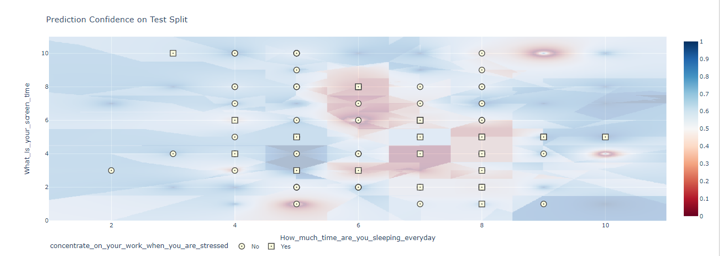
Display training and test splits
The train-test split procedure is used to estimate the performance of machine learning algorithms when they are used to make predictions on data not used to train the model.

Slide 29

Multi-class prediction confidence with go.Heatmap

Slide 30
import numpy as np
import plotly.express as px
import plotly.graph_objects as go
from sklearn.svm import SVR
mesh_size = .02
margin = 0
df = pd.read_csv('Survey on Student Mental Health1 (1).csv')
X = df[['How_much_time_are_you_sleeping_everyday','What_is_your_screen_time']]
y = df['Current_year_you_are_studying_in']
# Condition the model on How_much_time_are_you_sleeping_everyday and length, predict the petal width
model = SVR(C=1.)
model.fit(X, y)
# Create a mesh grid on which we will run our model
x_min, x_max = X.How_much_time_are_you_sleeping_everyday.min() - margin, X.How_much_time_are_you_sleeping_everyday.max() + margin
y_min, y_max = X.What_is_your_screen_time.min() - margin, X.What_is_your_screen_time.max() + margin
xrange = np.arange(x_min, x_max, mesh_size)
yrange = np.arange(y_min, y_max, mesh_size)
xx, yy = np.meshgrid(xrange, yrange)
# Run model
pred = model.predict(np.c_[xx.ravel(), yy.ravel()])
pred = pred.reshape(xx.shape)
# Generate the plot
fig = px.scatter_3d(df, x='How_much_time_are_you_sleeping_everyday', y='What_is_your_screen_time', z='Current_year_you_are_studying_in')
fig.update_traces(marker=dict(size=5))
fig.add_traces(go.Surface(x=xrange, y=yrange, z=pred, name='pred_surface'))
fig.show()

Slide 31
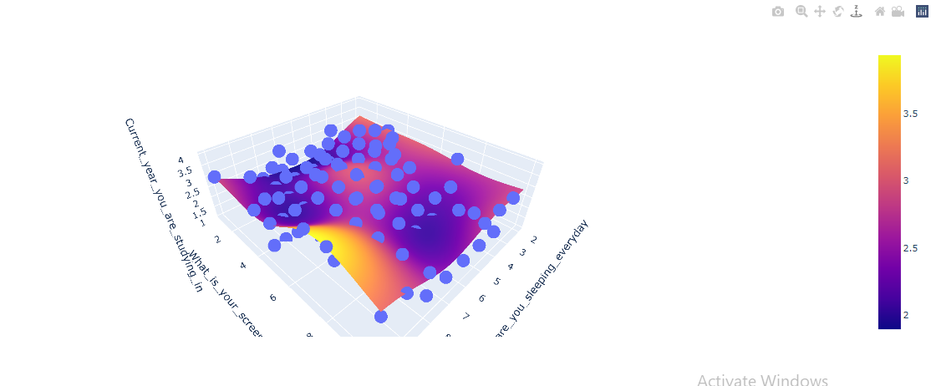
Multi-class prediction confidence with go.Heatmap
Multi-class prediction confidence with go.Heatmap is also possible to visualize the prediction confidence of the model using heatmaps. In this example, you can see how to compute how confident the model is about its prediction at every point in the 2D grid. Here, we define the confidence as the difference between the highest score and the score of the other classes summed, at a certain point.

